Slide 1
NativeScript.org
Going Beyond The {N} Basics
Summer of NativeScript
Clark Sell, TJ VanToll

Slide 2
Our Order Of Operations For Today
Navigation
Events
Layout
Modules / Controls
Data Binding
CSS

Slide 3


Slide 4
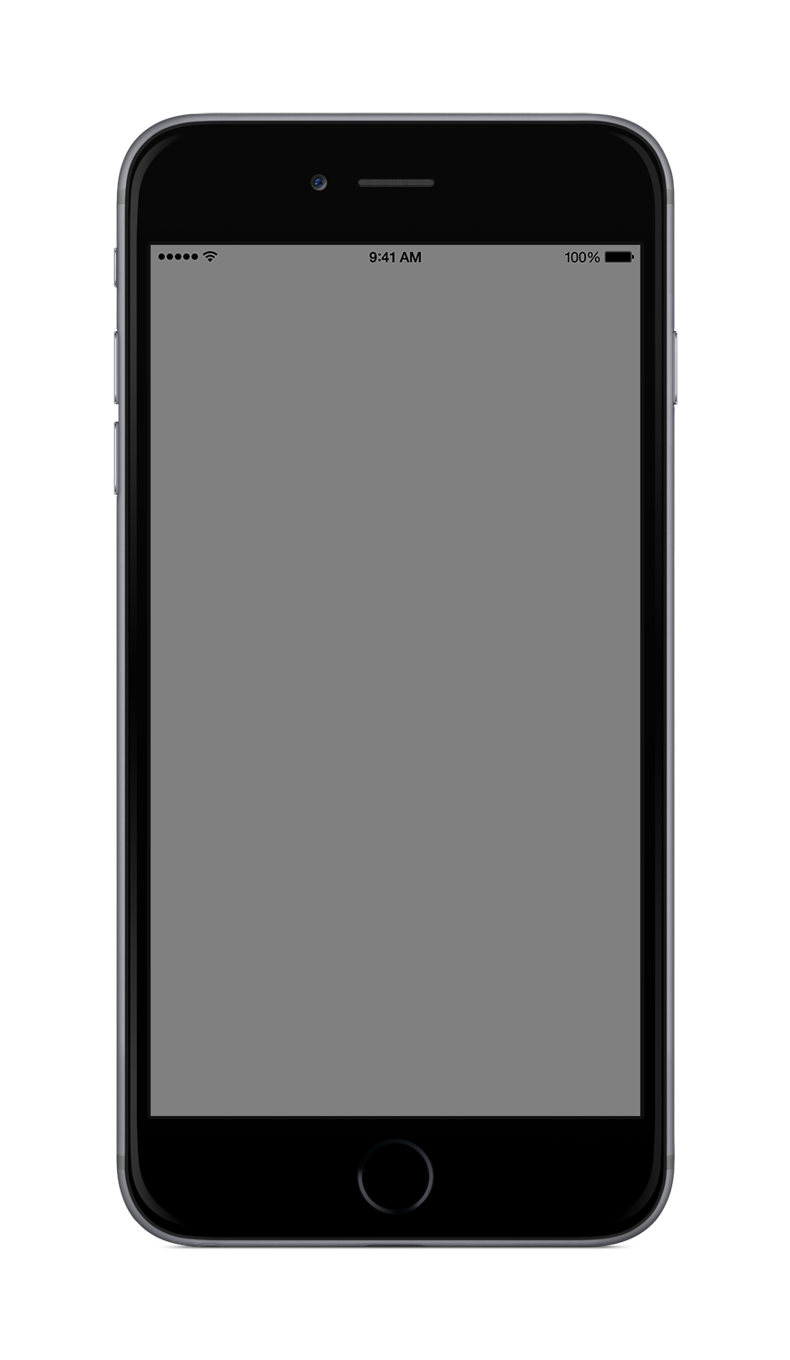
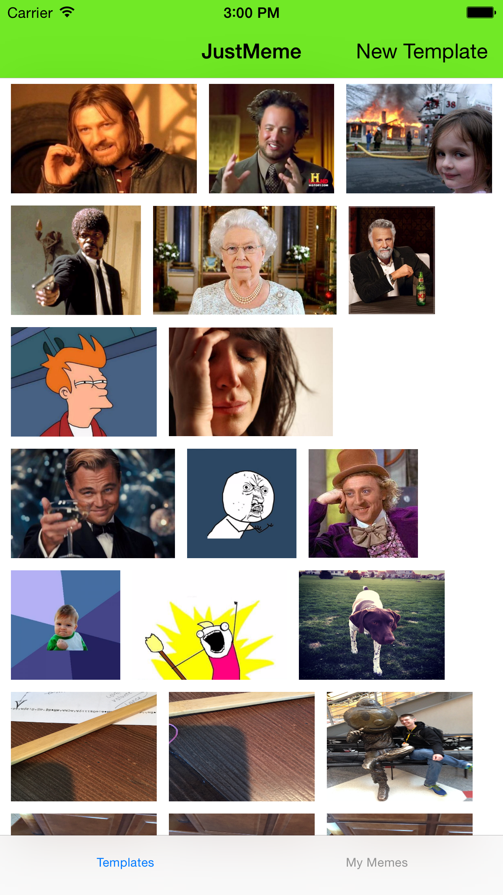

JustMeme

Slide 5
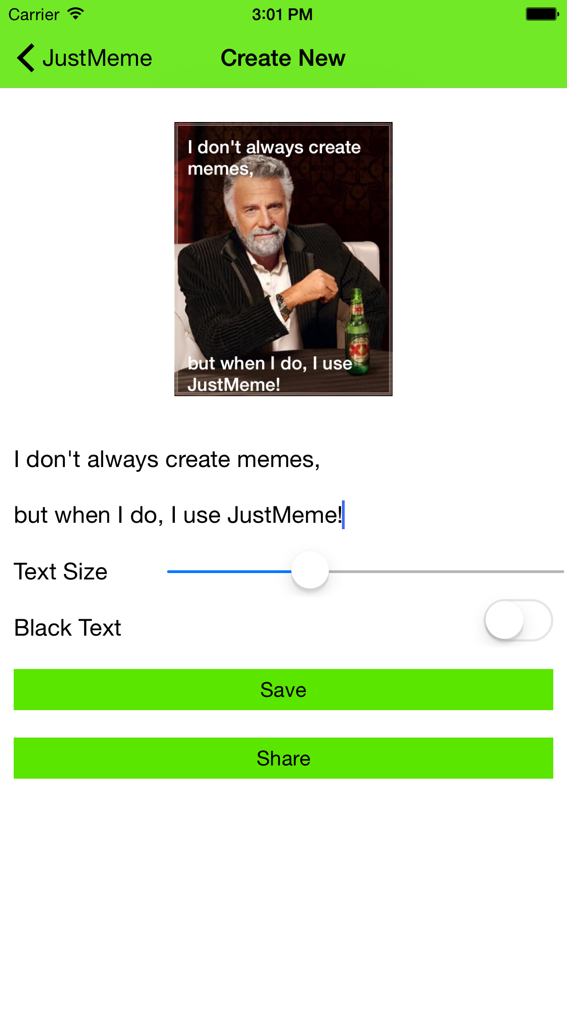
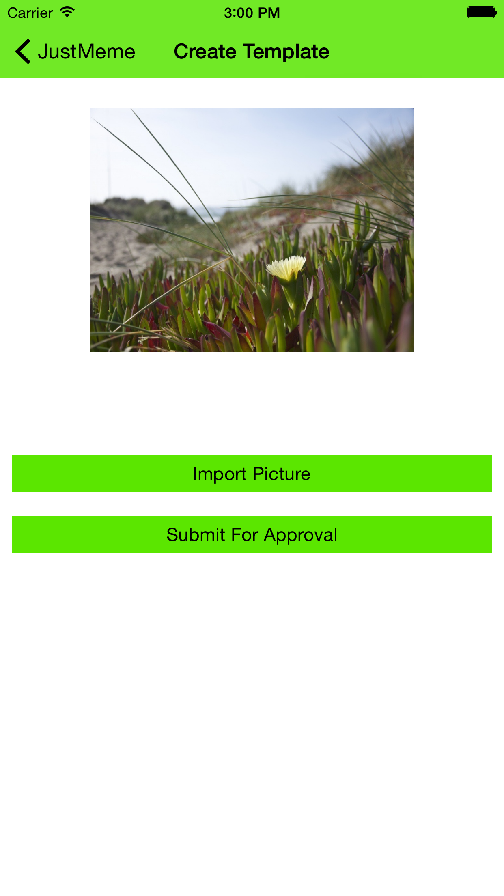

Slide 7
Images baked into the App
Images you saved locally
Images pulled from the cloud and saved locally

Slide 8
What is going on here???
Load the page
Cleanup any elements
Read local storage locations
Loop on items found
Create image elements
Assign a gesture to the image element
Assign a callback
Add to the right layout
Let the WrapLayout do the work.

Slide 9
oh those callbacks….
“I don’t normally just call functions,
but when I do I expect you to pass me along.”
ImageSource FTW!

Slide 10
Navigation

Slide 11
Navigation
What do we really care about?
How to get from here to there?
How can I pass something along the way?
What events do I pass during my trip?
Get me back home!

Slide 12
Navigation - the {N} way
Get the frame
Set some context
Navigate
var frameModule = require("ui/frame");
frameModule.topmost().navigate({
moduleName: "./components/create-meme/create-meme",
context: imageSource,
animated: true
});

Slide 13
Navigation - take me back
Easily pop back to the last thing in the stack.
Get the top frame
goBack()
var frameModule = require("ui/frame");
frameModule.topmost().goBack();

Slide 14
References
{N} Architecture and Navigation
Frame Module
Navigation in JustMeme
JustMeme - Navigate
JustMeme - goBack()

Slide 15

Lifecycle Events

Slide 16
Lifecycle Events
Application Level
Events which fire only based on the scope of the application itself.
View Level
Events which fire every time a page is brought into “focus”.
* there are also events on things like controls

Slide 17
Application Scope
onLaunch
onResume
onSuspend
onExit
onUncaughtError
onLowMemory
*not in order of execution

Slide 18
Wiring it up!
Get the application object
Assign your function
app.js
var application = require("application");
application.onExit = function () {
var analyticsMonitor = require("./shared/analytics");
analyticsMonitor.stop();
};

Slide 19
Page / View Level Events
navigatingTo
loaded
navigatedTo
navigatingFrom
navigatedFrom
unloaded
* in order of execution

Slide 20
Wiring up it up!
[yourView].xml
<Page
xmlns="http://www.nativescript.org/tns.xsd"
loaded="load"
unloaded="unloaded"
navigatedTo="navigatedTo">
[yourView’s].js
exports.load = function(args) {
//Seriously Awesome Stuff
};

Slide 21
References
Application Level Events
Application Callbacks
View Events
Page Events
Weak Events
JustMeme - App Events
JustMeme - View Events

Slide 22
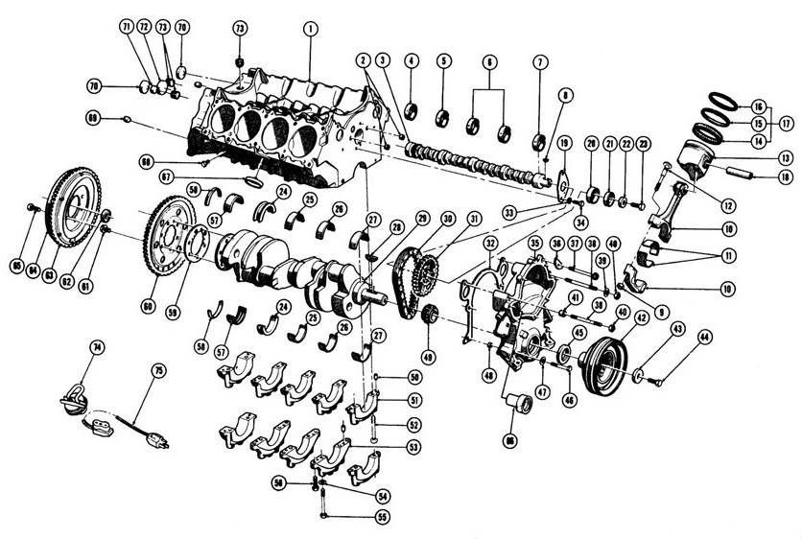
Layouting

Slide 23
Layouting
Layouting is the process of measuring and positioning the child views of a Layout container. Layouting is an intensive process whose speed and performance depend on the count of the children and the complexity of the layout container.
For example, a simple layout container such as AbsoluteLayout might perform better than a more complex layout container, such as GridLayout.
Layouting completes in two passes - a measure pass and a layout pass. Every layout container provides its own onMeasure() and onLayout() methods to achieve its own specific layouting.

Slide 24
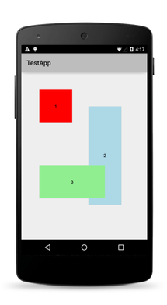
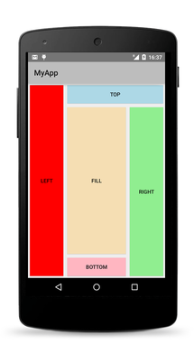
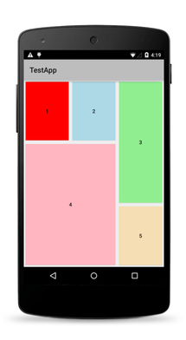
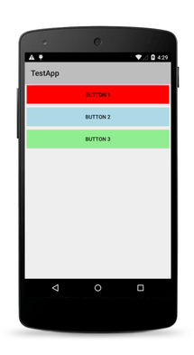
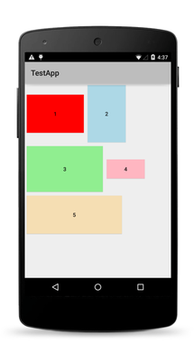
The 5 Layouts
Absolute
Dock
Grid
Stack
Wrap

Slide 25
AbsoluteLayout
This layout lets you set exact locations (left/top coordinates) for its children.
var absoluteLayout = new absoluteLayoutModule.AbsoluteLayout();
absoluteLayout.width = 230;
absoluteLayout.height = 230;
var label;
label = new labelModule.Label();
label.width = 100;
label.height = 100;
label.style.backgroundColor = new colorModule.Color("Red");
absoluteLayoutModule.AbsoluteLayout.setLeft(label, 10);
absoluteLayoutModule.AbsoluteLayout.setTop(label, 10);
absoluteLayout.addChild(label);

Slide 26
DockLayout
This layout arranges its children at its outer edges and allows its last child to take up the remaining space.
<Page>
<DockLayout stretchLastChild="true" >
<Button dock="left" text="left" />
<Button dock="top" text="top" />
<Button dock="right" text="right" />
<Button dock="bottom" text="bottom" />
<Button text="fill" />
</DockLayout >
</Page>

Slide 27
GridLayout
This layout defines a rectangular layout area that consists of columns and rows.
<GridLayout columns="80, *, auto" rows="auto, *" >
<Button col="0" />
<Button col="1" />
<Button col="2" />
<Button row="1" colSpan="3" />
</GridLayout>

Slide 28
StackLayout
This layout arranges its children horizontally or vertically. The direction is set with the orientation property.
<Page>
<StackLayout orientation="horizontal">
<Label text="This is Label 1" />
<Label text="This is Label 2" />
</StackLayout>
</Page>

Slide 29
WrapLayout
This layout positions its children in rows or columns, based on the orientation property, until the space is filled and then wraps them on a new row or column.
<WrapLayout itemHeight="100" horizontalAlignment="center">
<Label text="Label 1" />
<Label text="Label 2" />
<Label text="Label 3" />
<Label text="Label 4" />
</WrapLayout>

Slide 30
Layout References
Layouting
JustMeme - WrapLayout
JustMeme - A Grid in a Stack

Slide 31
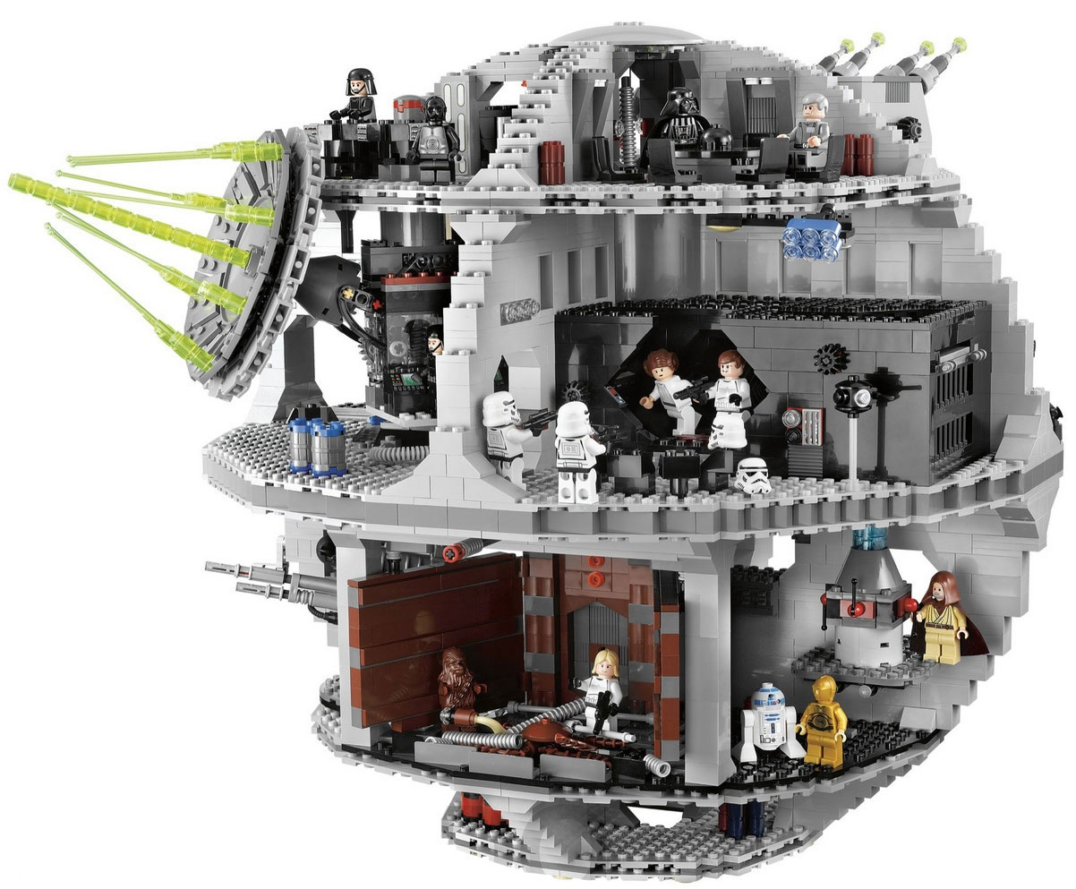
Modules Widgets

Slide 32
Module || Widget?
Well… both.
Generically speaking widgets are actually {N} modules. They work the same, are structured the same but a “widget” typically refers to a UI element. They are all contained in tns_modules.
├── app │ ├── App_Resources │ ├── LICENSE │ ├── README.md │ ├── app │ │ ├── app.css │ │ ├── app.js │ ├── package.json │ └── tns_modules │ ├── LICENSE │ ├── application │ │ ├── application-common.js │ │ ├── application.android.js │ │ ├── application.ios.js │ │ └── package.json │ ├── camera │ │ ├── camera.android.js │ │ ├── camera.ios.js │ │ └── package.json │ ├── ... └── platforms
“modules”

Slide 33
Where
└── tns_modules
├── application
├── camera
├── http
├── image-source
├── ui
│ ├── activity-indicator
│ │ ├── activity-indicator-common.js
│ │ ├── activity-indicator.android.js
│ │ ├── activity-indicator.ios.js
│ │ └── package.json
│ ├── border
│ ├── button
│ ├── content-view
│ ├── core
│ │ ├── bindable.js
│ │ ├── control-state-change.ios.js
│ │ ├── dependency-observable.js
│ │ ├── proxy.js
│ │ ├── view-common.js
│ │ ├── view.android.js
│ │ ├── view.ios.js
│ │ └── weak-event-listener.js
│ │ └── package.json
│ ├── layouts
│ │ ├── absolute-layout
│ │ ├── dock-layout
│ │ ├── grid-layout
│ │ ├── layout.js
│ │ ├── stack-layout
│ │ └── wrap-layout
│ │ └── package.json
│ ├── page
│ ├── ....
Located in: tns_modules/ui
Typically follow:
[name]-common.js
[name].ios.js
[name].android.js
package.json
“widget”

Slide 34

What’s in our toolbox
└── tns_modules
├── color
├── image-source
├── text
├── ui
│ ├── activity-indicator
│ ├── border
│ ├── builder
│ ├── button
│ ├── content-view
│ ├── core
│ ├── date-picker
│ ├── dialogs
│ ├── editable-text-base
│ ├── enums
│ ├── frame
│ ├── gestures
│ ├── image
│ ├── image-cache
│ ├── label
│ ├── layouts
│ ├── list-picker
│ ├── list-view
│ ├── page
│ ├── placeholder
│ ├── progress
│ ├── scroll-view
│ ├── search-bar
│ ├── segmented-bar
│ ├── slider
│ ├── styling
│ ├── switch
│ ├── tab-view
│ ├── text-base
│ ├── text-field
│ ├── text-view
│ ├── time-picker
│ ├── tool-bar
│ └── web-view

Slide 35


Slide 36
How to...
└── tns_modules
├── ui
│ ├── label
│ │ ├── label-common.js
│ │ ├── label.android.js
│ │ ├── label.ios.js
│ │ └── package.json
view.xml
Just reference the namespace.
view.js
Just reference the module.
<Page xmlns="http://www.nativescript.org/tns.xsd">
<StackLayout>
<Label text="Label 1" />
<Label text="Label 2" />
<Label text="Label 3" />
</StackLayout>
</Page>
var labelModule = require("ui/label");
var label = new labelModule.Label();
label.text = "{N}";

Slide 37
$(“#Label”)
No window, no problem.
Give the element an id.
Get It.
Use It.
<Page xmlns="http://www.nativescript.org/tns.xsd"
loaded=”load” >
<StackLayout>
<Label id=”OhGetMePlease” text="{N}" />
<Label text="Label 2" />
<Label text="Label 3" />
</StackLayout>
</Page>
var labelModule = require("ui/label");
var _page;
exports.load = function(args) {
_page = args.object;
};
exports.OhTapMe = function(args){
var myLabel = _page.getViewById("OhGetMePlease");
myLabel.text = "{N} is awesome";
};

Slide 38

Going {N}ative
iOS: UINavigationController
if (applicationModule.ios) {
var controller = frameModule.topmost().ios.controller;
var navigationItem = controller.visibleViewController.navigationItem;
navigationItem.setHidesBackButtonAnimated(true, false);
var navBar = controller.navigationBar;
navBar.barTintColor = UIColor.colorWithRedGreenBlueAlpha(.35, .90, .0, 1.0);
navBar.barStyle = 0;
navBar.tintColor = UIColor.blackColor();
navBar.titleTextAttributes =
new NSDictionary(
[UIColor.blackColor()],
[NSForegroundColorAttributeName]);
}

Slide 39
Module References
Widgets

Slide 40

{{ Data Binding }}

Slide 41
{{ defined }}
Data binding is the process of connecting application user interface (UI) to a data object (business model).
With a correct data binding settings and if data object provides proper notifications then when data changes application UI will reflect changes accordingly (source to target).
Depending on settings and requirements there is a possibility to update data from UI to data object (target to source).

Slide 42
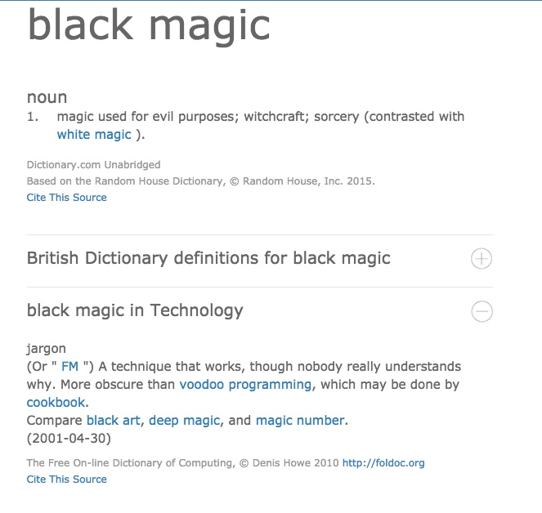

{{ }}

Slide 43


Slide 44

{{ sayWAT }}
<Page xmlns="http://www.nativescript.org/tns.xsd"
loaded=”load” >
<StackLayout>
<Label id=”OhGetMePlease” text="{{N}}" />
<Label text="Label 2" />
<Label text="Label 3" />
</StackLayout>
</Page>

Slide 45
{{ bindingContext }}
<Page xmlns="http://www.nativescript.org/tns.xsd"
loaded=”load” >
<StackLayout>
<Label id=”OhGetMePlease” text="{{N}}" />
<Label text="Label 2" />
<Label text="Label 3" />
</StackLayout>
</Page>
var observableModule = require("data/observable");
var _viewData = new observableModule.Observable();
var _page;
exports.load = function(args) {
_page = args.object;
_viewData.set( "N", "awesome" );
_page.bindingContext = _viewData;
};

Slide 46
{{ Express YOself }}
<Label text="{{ author ? 'by ' + author : '[no author]' }}" />
<Label text="{{ author || '[no author]' }}" />

Slide 47
{{ Event Binding }}
<Page xmlns="http://www.nativescript.org/tns.xsd"
loaded=”load” >
<Button
text="{{ N }}"
tap="{{ myBtn }}" />
</Page>
var observableModule = require("data/observable");
var _viewData = new observableModule.Observable();
var _page;
exports.load = function(args) {
_page = args.object;
_viewData.set( "N", "awesome" );
_page.bindingContext = _viewData;
};
exports.myBtn = function(args) {
_viewData.set( "N", "CLICKED!!!" );
};

Slide 48
Data Binding References
Data Binding
UI Binding
Observable
ObservableArray
JustMeme - {{ }}
JustMeme - bindingContext

Slide 49

Style

Slide 50
CSS - FTW!
You change the looks and appearance of views (elements) in a NativeScript application similarly to how you do it in a web application—using Cascading Style Sheets (CSS) or changing the style object of the elements in JavaScript.
Only a subset of the CSS language is supported.

Slide 51
Apply at 3 Different Levels
├── app
│ ├── app.css
│ ├── app.js
│ ├── components
│ │ ├── create-template
│ │ │ ├── create-template.css
│ │ │ ├── create-template.js
│ │ │ └── create-template.xml
│ │ ├── home
│ │ │ ├── home.css
│ │ │ ├── home.js
│ │ │ └── home.xml
Application
Applies to every application page
Page
Applies to the page's UI views
InLine
Applies directly to a UI view

Slide 52
Supported Selectors
Type
Class
ID
<Label />
Label { color: “white” }
<Label cssClass=”ME” />
.ME { color: “white” }
<Label id=”ME” />
#ME { color: “white” }

Slide 53
Style References
UI Styling
Supported Properties
JustMeme - app’s css
JustMeme - home’s css

Slide 54


Slide 55
What’s next?
Screen Sizes
Application Settings
Custom Events
Weak Events / Memory Leaks
Dialogs / Action Sheets
Gestures
Placeholder

Slide 56
Just Remember
http://NativeScript.org

Slide 57


